Slide 1
Html5 and CSS3
Parker Zhou
parkerzho2010@gmail.com

Slide 2
Hello
Instructor: Parker Zhou
Javascript CSS HTML C# ASP.NET C/C++ Nginx

Slide 3
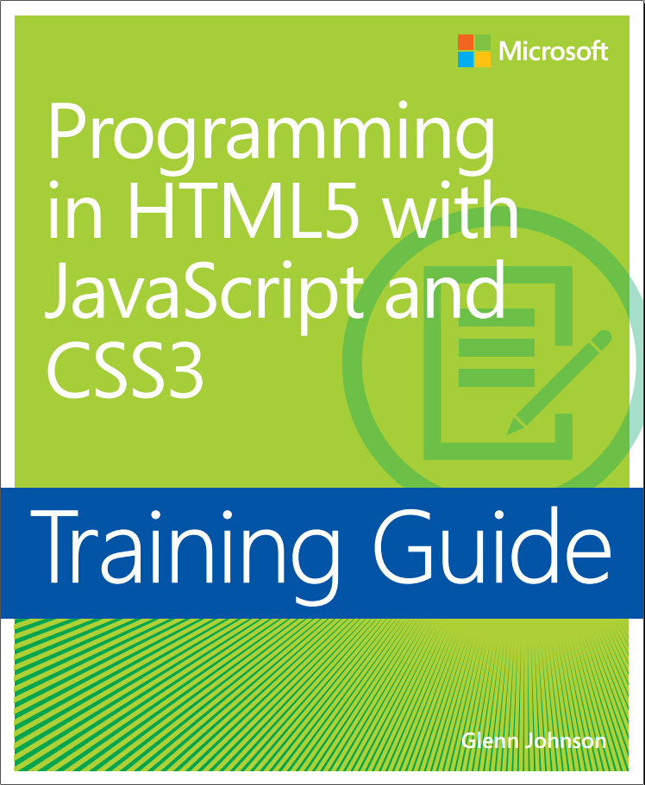
About the book
Notes:
Skip chapter1 and chapter2
a few chapter is talking about server programming
I will not follow the book exactly, but the contents can be almost covered. And I will also add some practical skill during the trainning

Slide 4
Course Outline
Day 1
Introduction to Javascript
Introduction to CSS
Day 2
Jquery
XMLHttpRequest
Day 3
Javascript OOP
Semantic Html
Form Control
Day 4
WebSockets
Canvas and SVG
Geolocation
Day 5
Drag and Drop
MutiMedia
Storage API
Offline Application
Notes:
Exercise

Slide 5

Notes:
Welcome to the world of html5

Slide 6
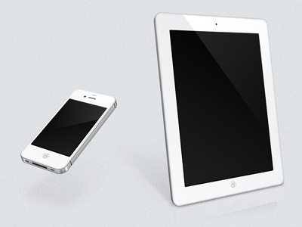
Why Html5?
Mobile Internet

Slide 7
Why Html5?
Html5 is mobile friendly
Html5 is more powerful than its predecessor
Why not app? - Html5 is cross-platform
App still does it better in interaction and performance nowadays, but browser is becoming better and better
Notes:
http://mobile.test.clippererm.com

Slide 8
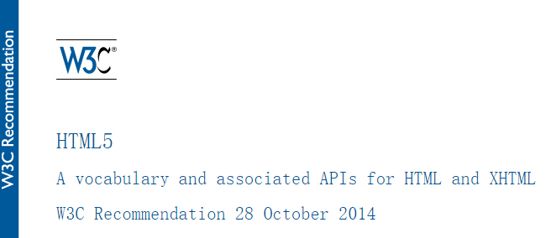
HTML5 published!
http://www.w3.org/TR/html5/
Notes:
Mean recommends widely use

Slide 9








HTML5 Summary
SEMANTICS
CONNECTIVITY
OFFLINE & STORAGE
MULTIMEDIA
3D, GRAPHICS & EFFECTS
PERFORMANCE & INTEGRATION
DEVICE ACCESS
STYLING

Slide 10
SEMANTICS
Allows you to describe more precisely what your content is.
New outlining and sectioning elements(section aside header footer video…)
New form control and api

Slide 11
CONNECTIVITY
Allows you to communicate with the server in new and innovative ways.
WebSockets

Slide 12
OFFLINE & STORAGE
Allows webpages to store data on the client-side locally and operate offline more efficiently.
Application cache
Storage API : session storage and local storage
File API
Indexed DB\Web SQL

Slide 13
MULTIMEDIA
Makes video and audio first-class citizens in the Open Web.
<audio> and <video>
Track and WebVTT

Slide 14
3D, GRAPHICS & EFFECTS
Allows you use a much more diverse range of presentation options.
Canvas
WebGL
SVG

Slide 15
PERFORMANCE & INTEGRATION
Provides greater speed optimization and better usage of computer hardware.
XMLHttpRequest
Web Workers
History API
Drag and Drop

Slide 16
DEVICE ACCESS
Allows for the usage of various input and output devices
Camera API
Touch events
Geolocation
Device orientation
Pointer Lock API

Slide 17
STYLING
Lets authors write more good looking themes.
CSS

Slide 18
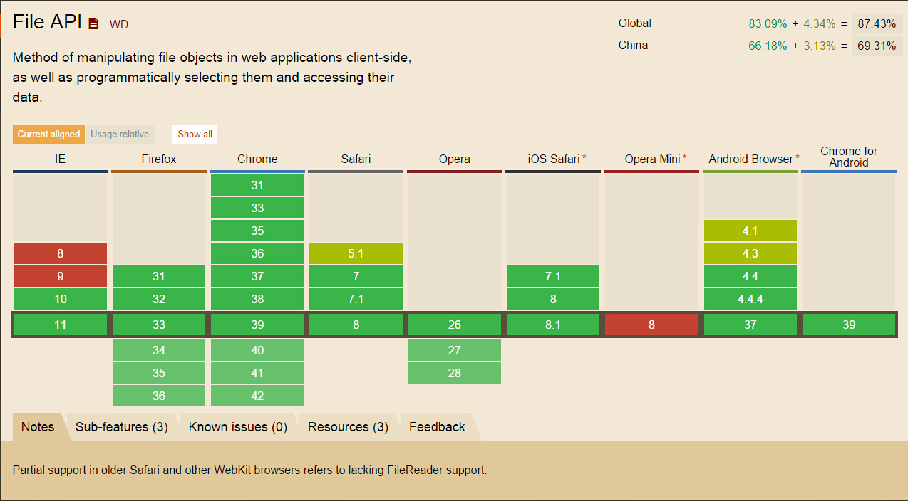
Browser Support
http://caniuse.com/

Slide 19
Browser Support
Modernizr
html5shiv
Notes:
Modernizr example : http://nartfest.com

Slide 20
Tools
Chrome – run,test,debug
Sublime - editor

Slide 21
Useful Resource
http://caniuse.com/
http://html5test.com/
https://developer.mozilla.org/en-US/docs/Web/Guide/HTML/HTML5
http://www.w3.org/

